Slide 1
EMPLOYEES AND EMPLYMENT TRENDS
MPU 3362 & VC1
Integrity

Slide 2


Slide 3

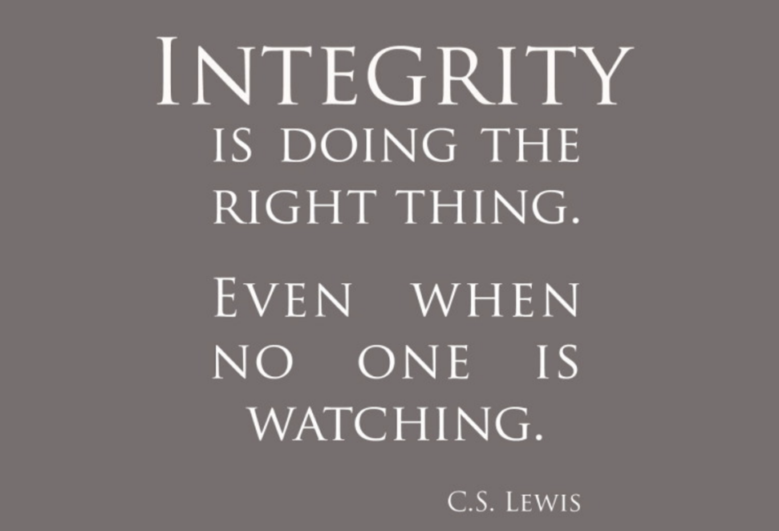
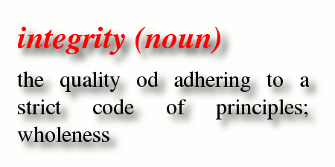

Slide 4
What is Integrity?
Having integrity means doing right thing in a reliable way
Its actually a ‘Quality’ of being honesty and having strong moral
values
Basic idea of the integrity is- “Doing right thing when nobody’s
watching you”
- The quality of being honest and having strong moral principles.

Slide 5
Integrity at workplace
Don’t let teammates take the fall. Work together as a team. This builds trust and shows integrity.
Never steal supplies from the work place.
If you find yourself in a conflict of interest ,get out of it as soon as possible.
Don’t accept praise of acclaim for some one else’s work. That includes stealing someone’s idea or pretending to have worked on a successful project
If your company asks you to do something against your personal code of conduct ,refuse. If it means losing a good paying job ,so be it, find a more ethical company to work for

Slide 6
WHY IS INTEGRITY IMPORTANT?
1) Does customer wants to deal with an organisation that doesn't keep their word, or that offers bad products or services? They wouldn't.
2) Instead they would want to deal with the organisation who can be trusted, that have trustworthy employees and a good brand message.
3) Integrity is not just important on a personal level, it is also vitally important at a workplace level. Organizations known for their integrity perform better.

Slide 7
GUIDELINES FOR DEMONSTRATING INTEGRITY IN THE WORK PLACE
Build trusting and respectful relationships
Communicate openly and honestly
Follow Company Policies
Demonstrate Responsible Behaviour
Work Diligently
Admit to and Learn from Your Mistakes
Stand Up for Your Beliefs
Have Your Own Identity

Slide 8
PROFESSIONAL MATURITY HELPS IN THE WORKPLACE
1) Professional maturity is the ability to respect other people’s diversified cultural backgrounds and unique set of experience.
2) In the workplace judgment should be based on mutual consensus supported with facts ,rather than emotional and instincts .
3) It is also ability to control anger and settle differences without violence.
4) A mature person can face unpleasantness ,frustration, discomfort and defeats without collapsing or complaining.
“

Slide 9
Honesty is the best policy” “Your reputation is more important than your paycheck, and your integrity is worth more than your career”
Slide ‹#› of 9

